Slide 1

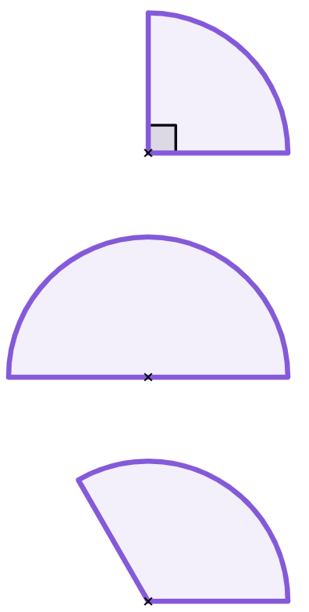
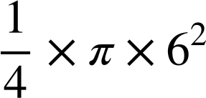
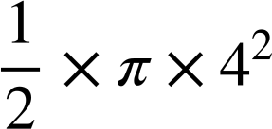
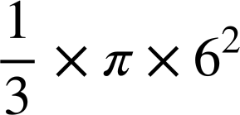



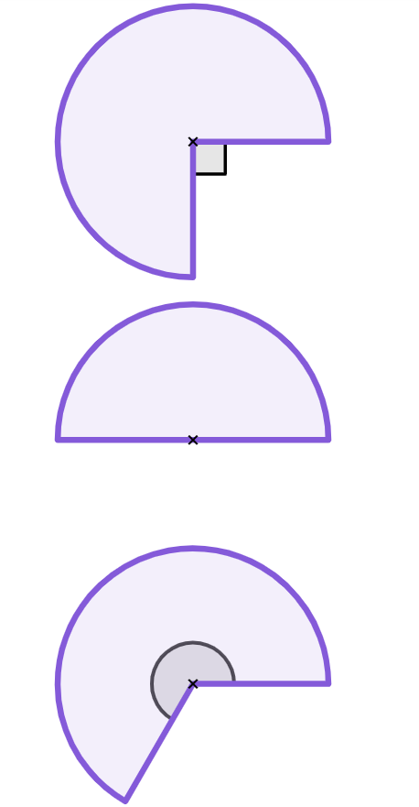
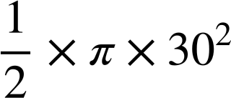

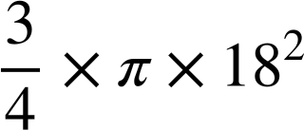


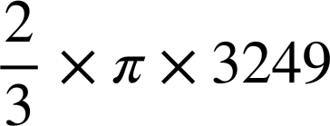
Area of composite shapes
Task A: Finding the area of sectors of a circle
1) Match the circle sectors with the possible correct calculations and answers. Some calculations do not match with a sector.
1
2
3
120°
r = 6 cm
r = 4 cm
r = 6 cm
d
c
b
g
f
h
2) Complete the table. Give your answer both as a decimal (rounded to 1 d.p.) and in terms of π.
sector | step 1 | step 2 | answer (cm²)
 |  |  | 450π 1413.7
 |  |  | 243π 763.4
 |  |  | 2166π 6804.7
a)
30 cm
b)
18 cm
c)
2
240°
3
or
57 cm
240
360

Slide 2
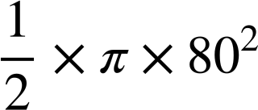

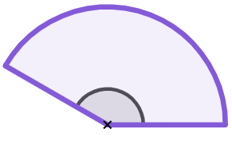
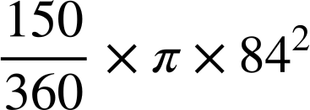
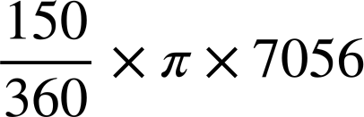
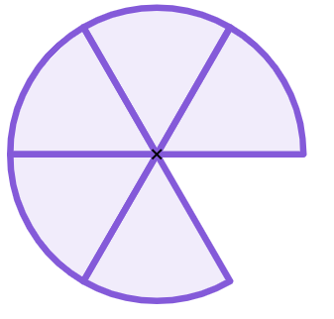
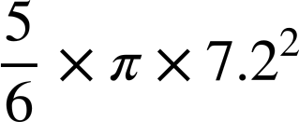
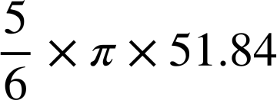
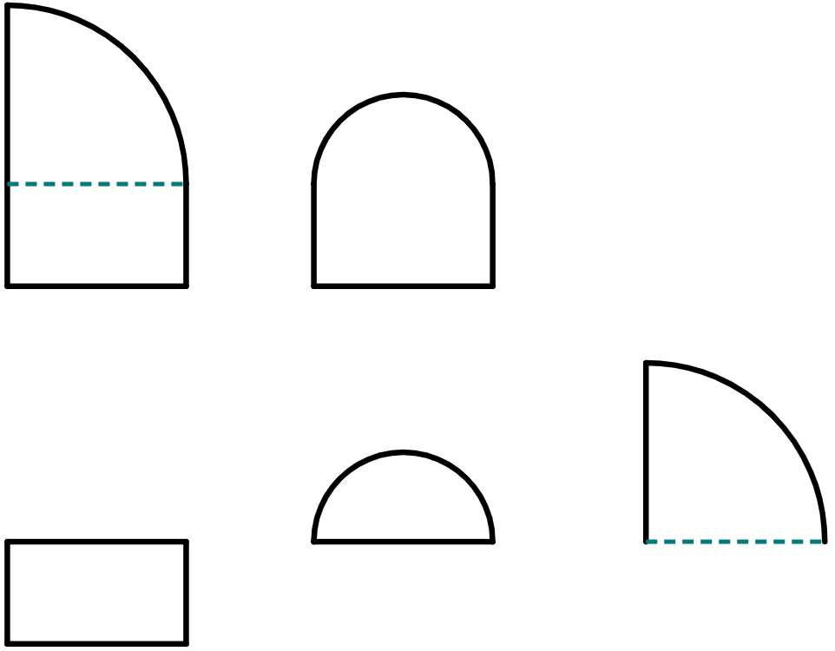
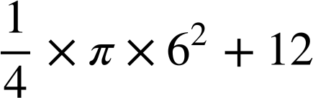
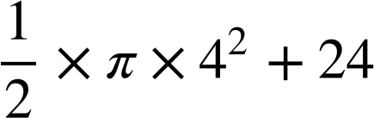
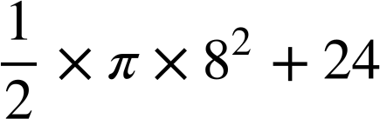
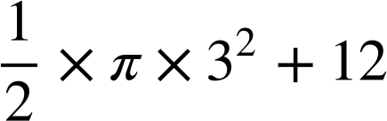
Area of composite shapes
2) Complete the table. Give your answer both as a decimal (rounded to 1 d.p.) and in terms of π.
sector | step 1 | step 2 | answer (cm²)
 |  |  | 3200π 10 053.1
 |  |  | 2940π 9236.3
 |  |  | 43.2π 135.7
d)
d = 160 cm
e)
150°
84 cm
f)
7.2 cm
Task B: Finding the area of composite shapes with sectors
1) Match the composite shape to its component parts and calculations.
d
2 cm
These did not match with either shape.
c
6 cm
6 cm
2 cm
i
b
6 cm
8 cm
shape 1
e
f
8 cm
3 cm
4 cm
g
3 cm
shape 2
a
3 cm
h
8 cm
j

Slide 3
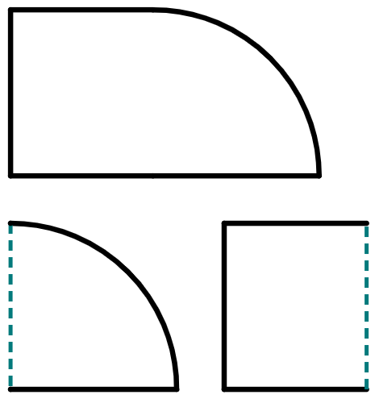
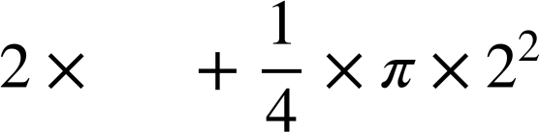
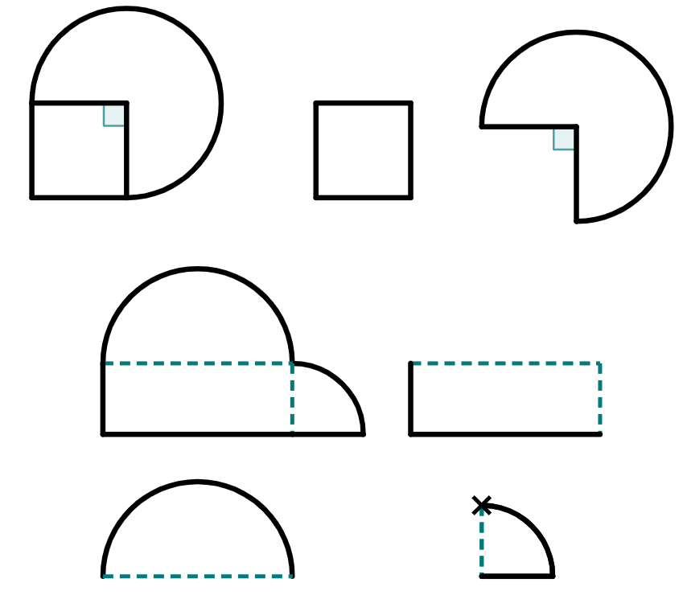

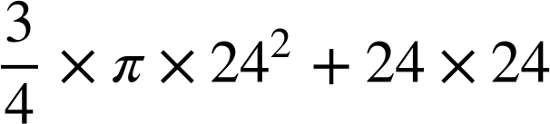
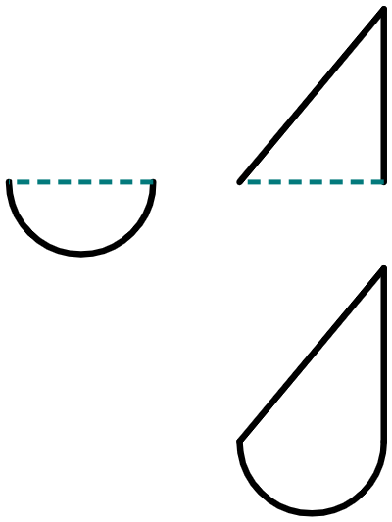
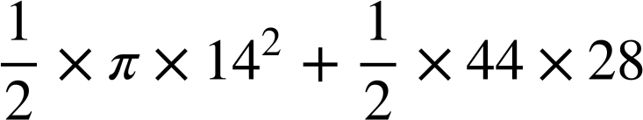
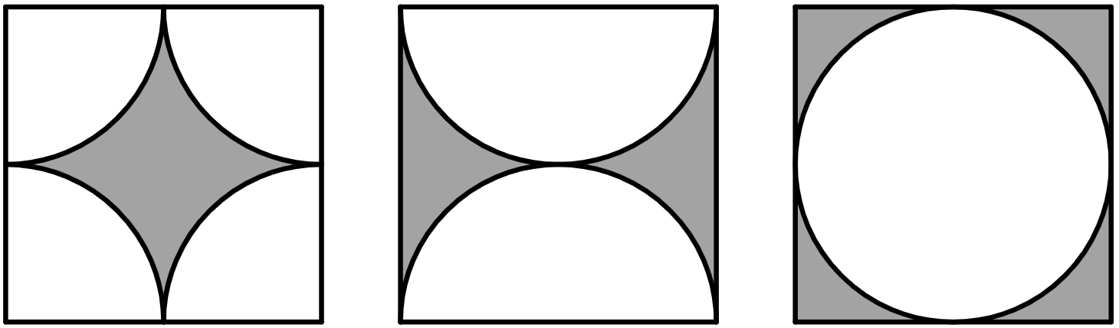
Area of composite shapes
2) Complete the table. Give your answer as both a decimal and in terms of π
shape | shape broken into parts | calculations (addition) | answer
 |  |  | π + 14 17.1 cm²
 |  |  | 164π + 384 889.2 cm²
 |  |  | 432π + 576 1933.2 cm²
 |  |  | 98π + 616 923.9 cm²
a)
7
7 cm
___ cm
2 cm
2 cm
7
b)
12
12 cm
32 cm
16
32 cm
12 cm
12
32
c)
24 cm
d)
24 cm
24 cm
28 cm
28 cm
44 cm
44 cm
3) What do you notice about the areas of each shaded region?
Show your working to support your observations.
¼
circle
¼
circle
½
circle
8 cm
¼
circle
¼
circle
½
circle
The area of each shaded region is equal, as the empty space in each shape can be rearranged to create one full circle. The area of the shaded region is 64 – 16π.
Mathematics in Education and Industry.

